Slide 1
Operators

Slide 2
What is Operators?
Operators perform operations on data:
Arithmetic Operators
Comparison Operators
Logical Operators

Slide 3
Arithmetic Operators

Slide 4
Arithmetic Operators on integer and float
+ (addition)
- (subtraction)
* (multiplication)
/ (division)
** (exponentiation)
// (integer division)
% (modulo): Get remaining of division

Slide 5
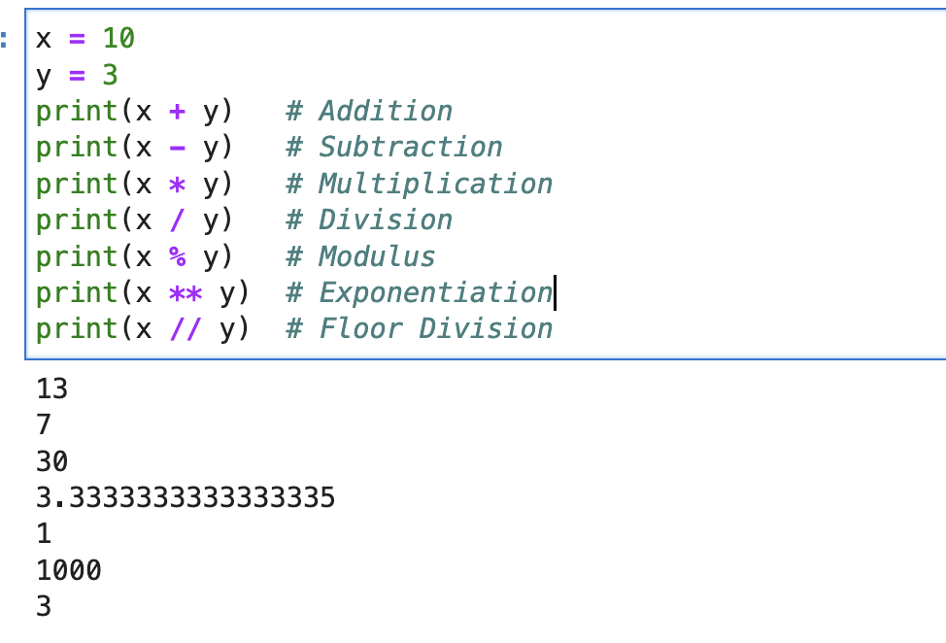
Code Sample - Arithmetic Operators on integer and float

Slide 6
Arithmetic Operators (For string)
+ (concat)
* (multiplication)

Slide 7
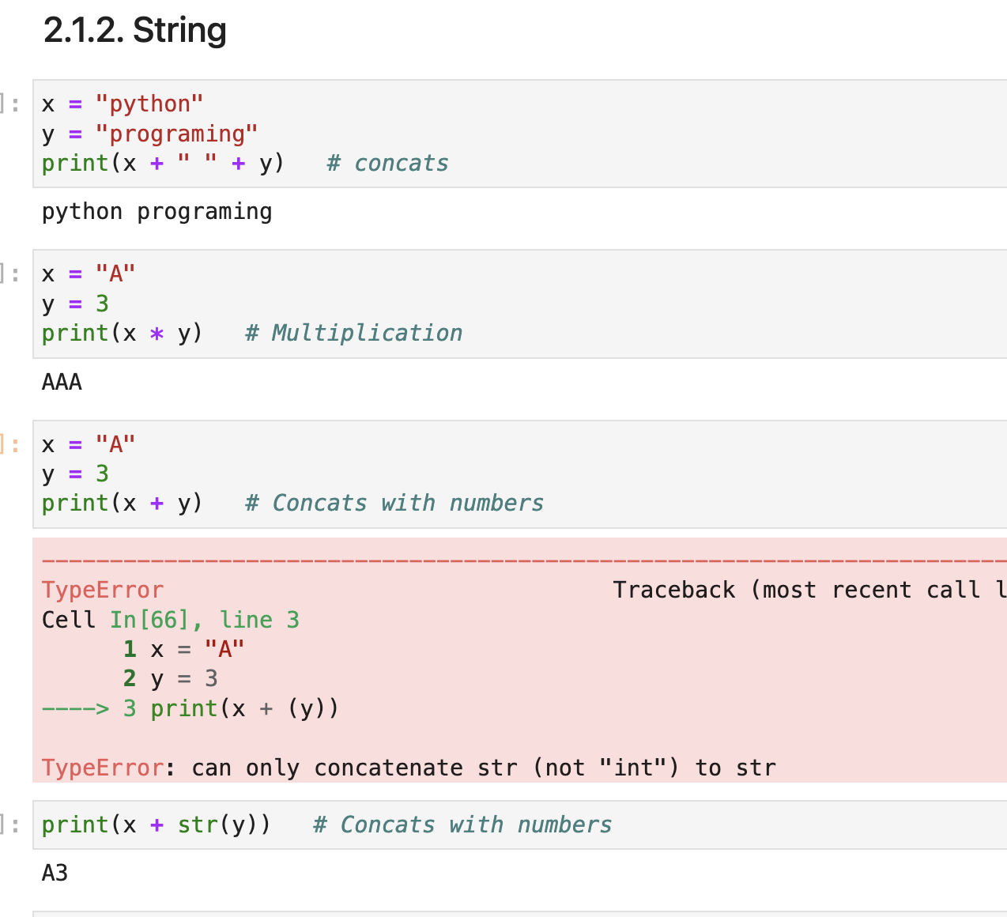
Arithmetic Operators (On string)

Slide 8
More Operation with String!

Slide 9
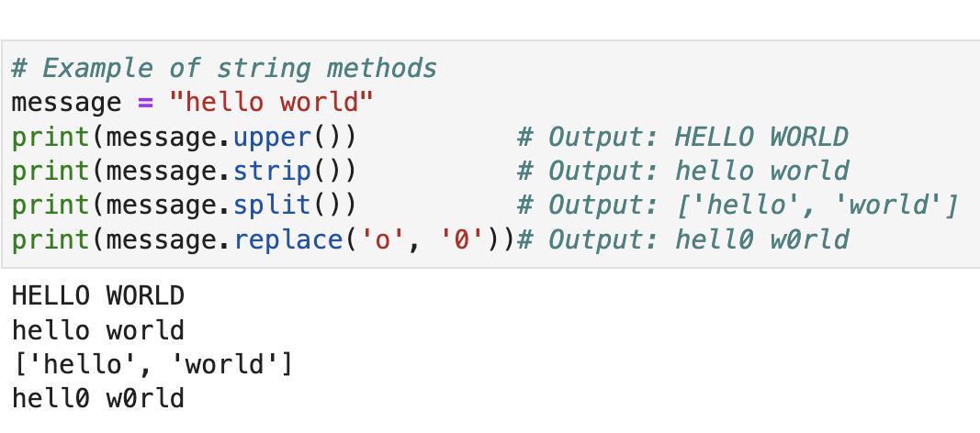
String Methods
Code Sample
Python provides numerous built-in methods for string manipulation, such as:
upper()
lower()
strip()
split()
replace(), and more.

Slide 10
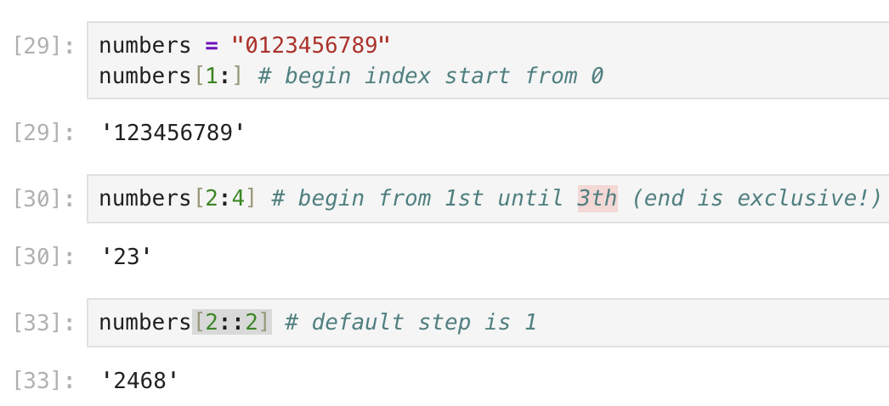
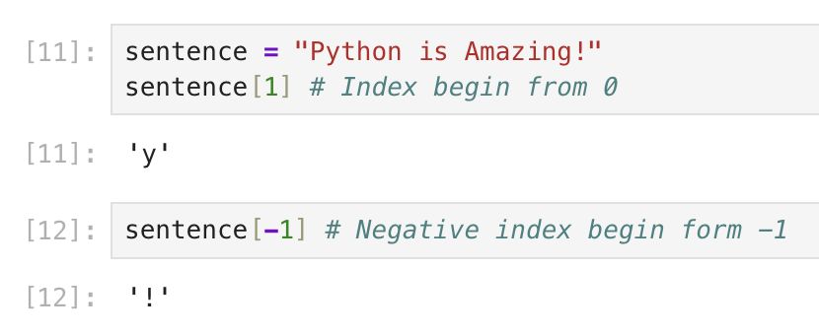
String Indexing
String Slicing
Extract character from String
Extracting Substrings from a string using slicing notation
Syntax: string[index]
Syntax: string[begin:end:step]

Slide 11
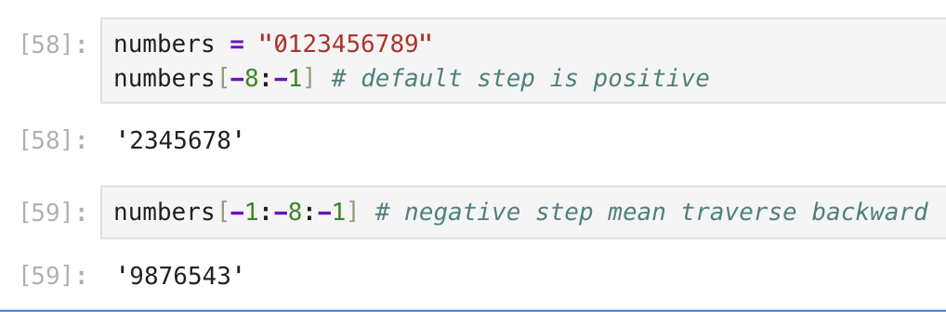
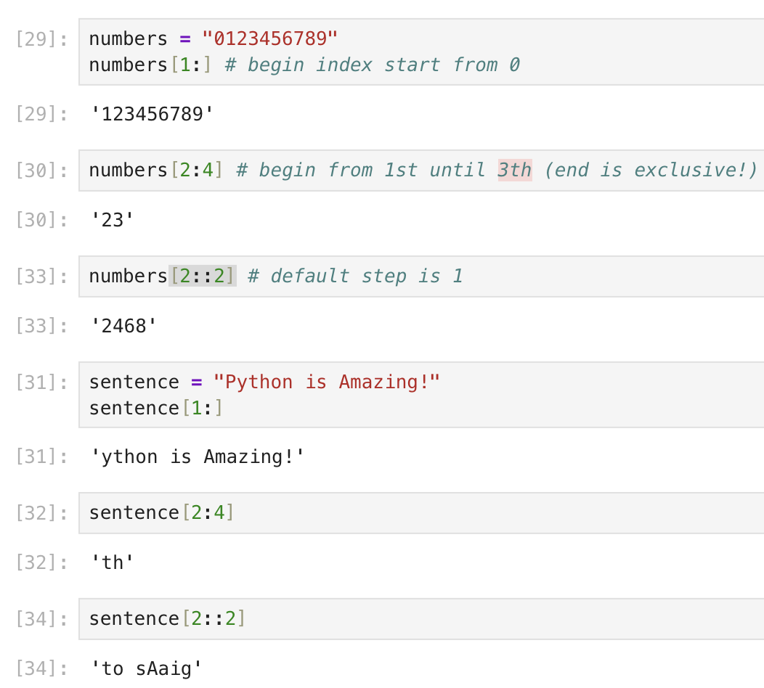
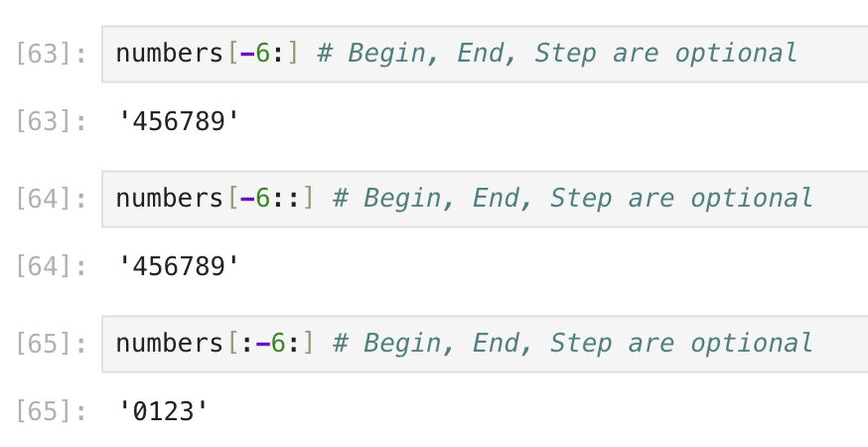
Positive String slicing
Negative String slicing

Slide 12
Comparison Operators

Slide 13
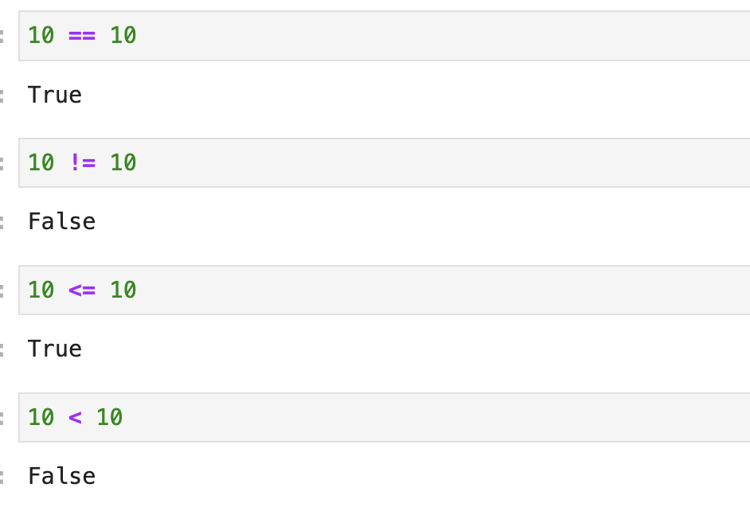
Comparison Operators
Numerical Comparison
== (equal to)
!= (not equal to)
< (less than)
> (greater than)
<= (less than or equal to)
>= (greater than or equal to)

Slide 14
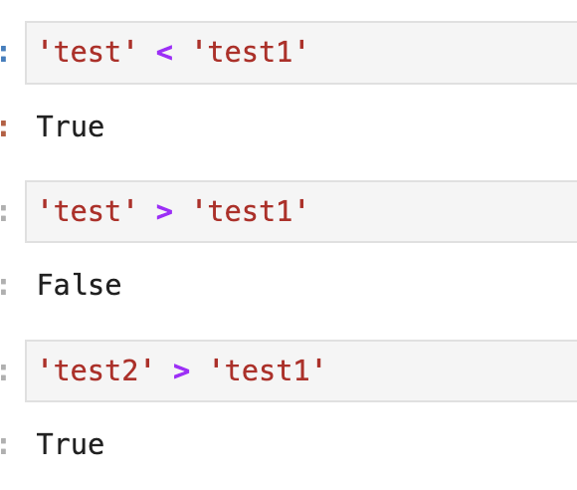
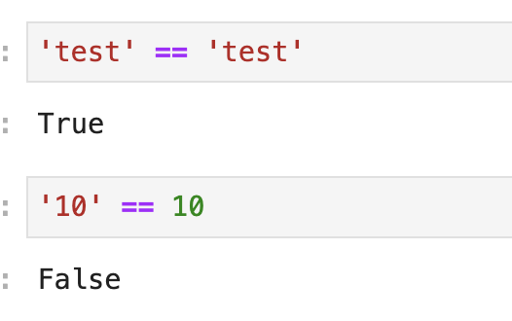
Equal Comparison
Size Comparison (sort)
Comparison on String Data Type

Slide 15
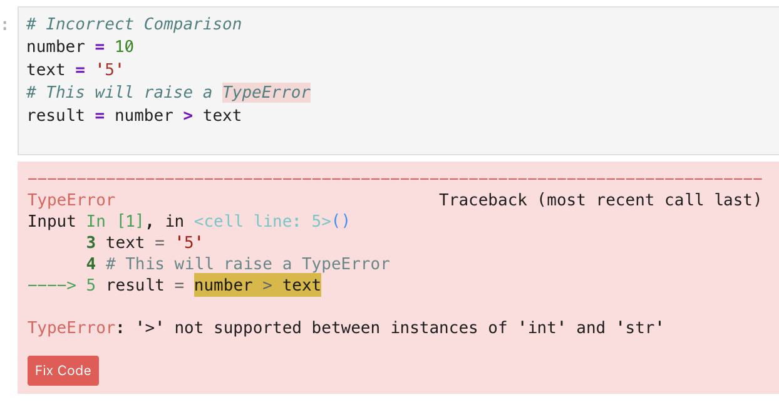
Incompatible Comparisons
Python is a strictly typed system for comparison; data that are inherently different cannot be compared using logical operators.
Key takeaway: Ensure operand types match before using logical operators.

Slide 16
Logical Operators

Slide 17
Logical Operators
and (both conditions true)
or (at least one condition true)
not (inverts the truth value)

Slide 18
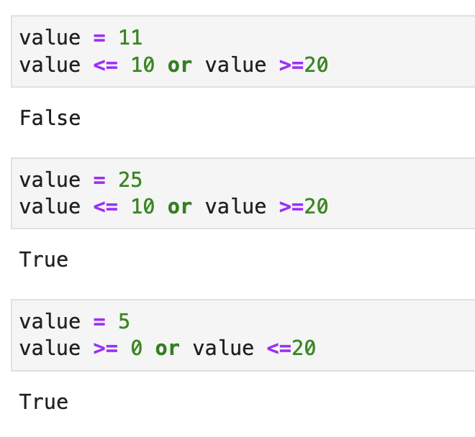
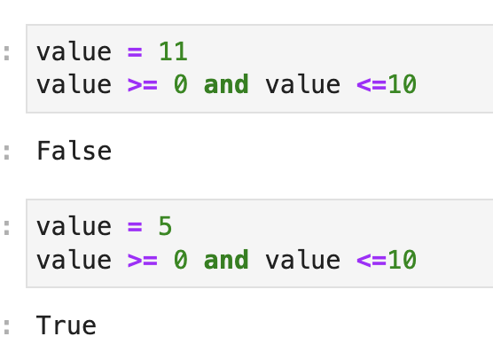
and (both conditions true)
or (at least one condition true)

Slide 19
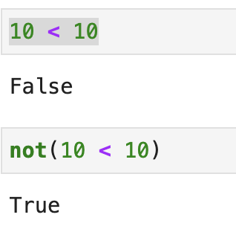
Not (inverts the truth value)

Slide 20
TRY IT YOURSELF

Slide 21
Arithmetic Operators
Do math on numbers and strings: + - * / ** // %

Slide 22
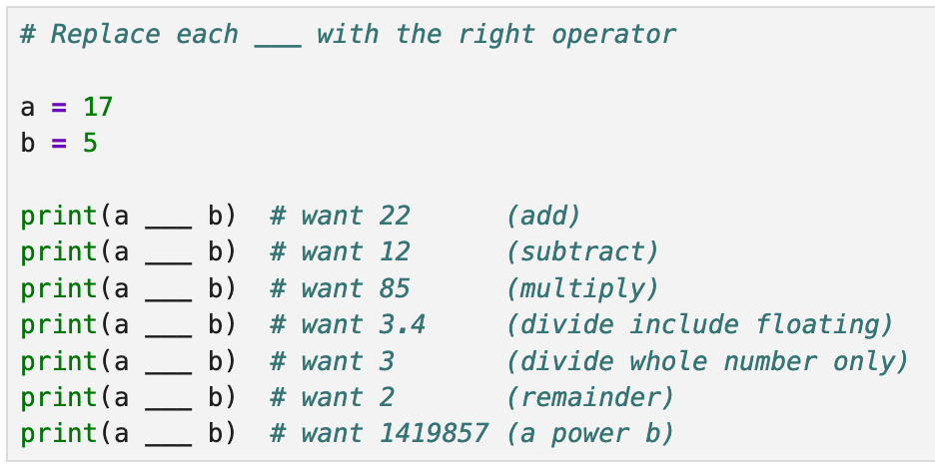
Arithmetic Operation
Your task
Replace every ___ with the operator that gives the wanted value.
Mind the difference between / (float), // (whole), and % (remainder).
Stretch: change a and b, then predict each line before running.
Notes:
# Replace each ___ with the right operator
a = 17
b = 5
print(a ___ b) # want 22 (add)
print(a ___ b) # want 12 (subtract)
print(a ___ b) # want 85 (multiply)
print(a ___ b) # want 3.4 (divide include floating)
print(a ___ b) # want 3 (divide whole number only)
print(a ___ b) # want 2 (remainder)
print(a ___ b) # want 1419857 (a power b)

Slide 23
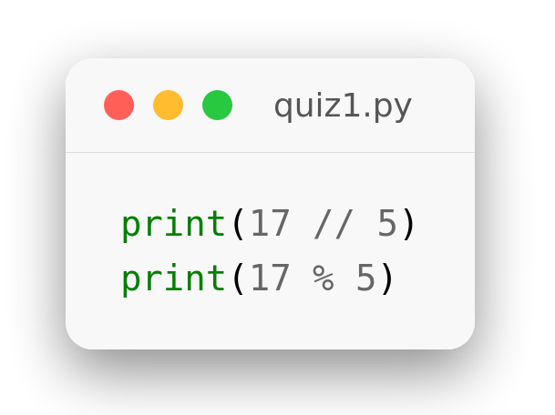
Division & Modulo
KNOWLEDGE CHECK
A. 2 and 3
B. 3.4 and 2
C. 3 and 2
D. 12 and 5
Notes:
print(17 // 5)
print(17 % 5)

Slide 24
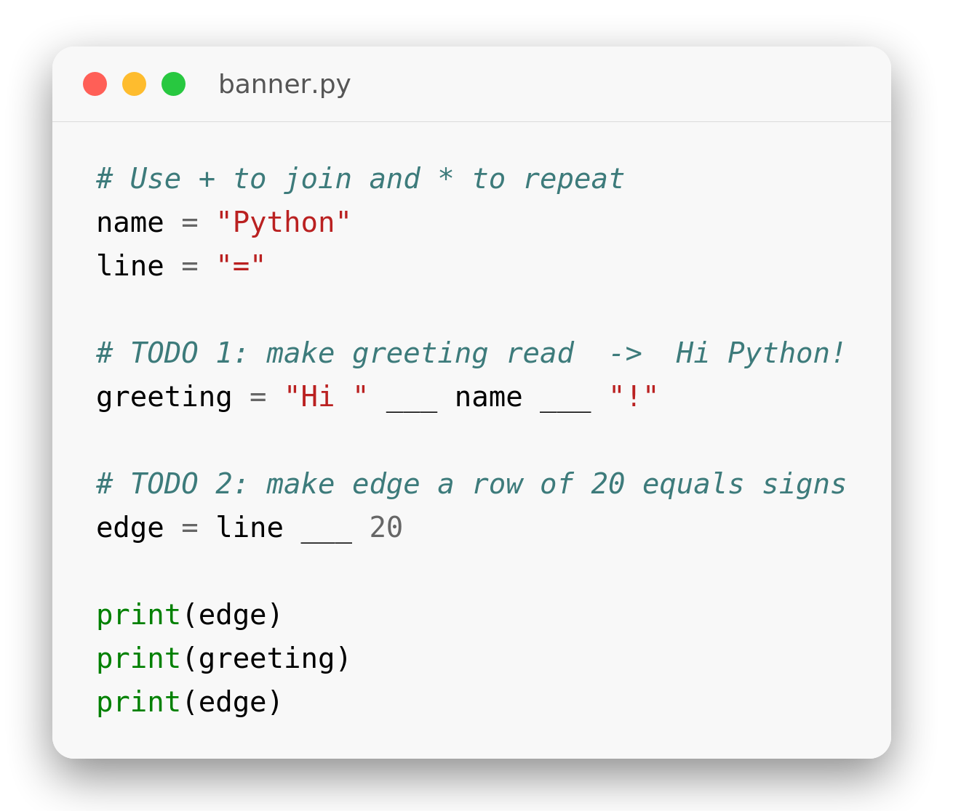
String Arithmetic
TRY IT YOURSELF · ~6 MIN
Your task
Use + to join strings together and * to repeat one.
TODO 1 builds the greeting; TODO 2 builds the 20-character edge line.
Run it — the output should be a banner box around Hi Python!
Insight: + joins string-to-string only; adding a number needs str(...) first.
Expected output
====================
Hi Python!
====================
Notes:
name = "Python"
line = "="
greeting = "Hi " + name + "!"
edge = line * 20
print(edge)
print(greeting)
print(edge)

Slide 25
String Methods
Transform text with upper() lower() strip() split() replace()

Slide 26
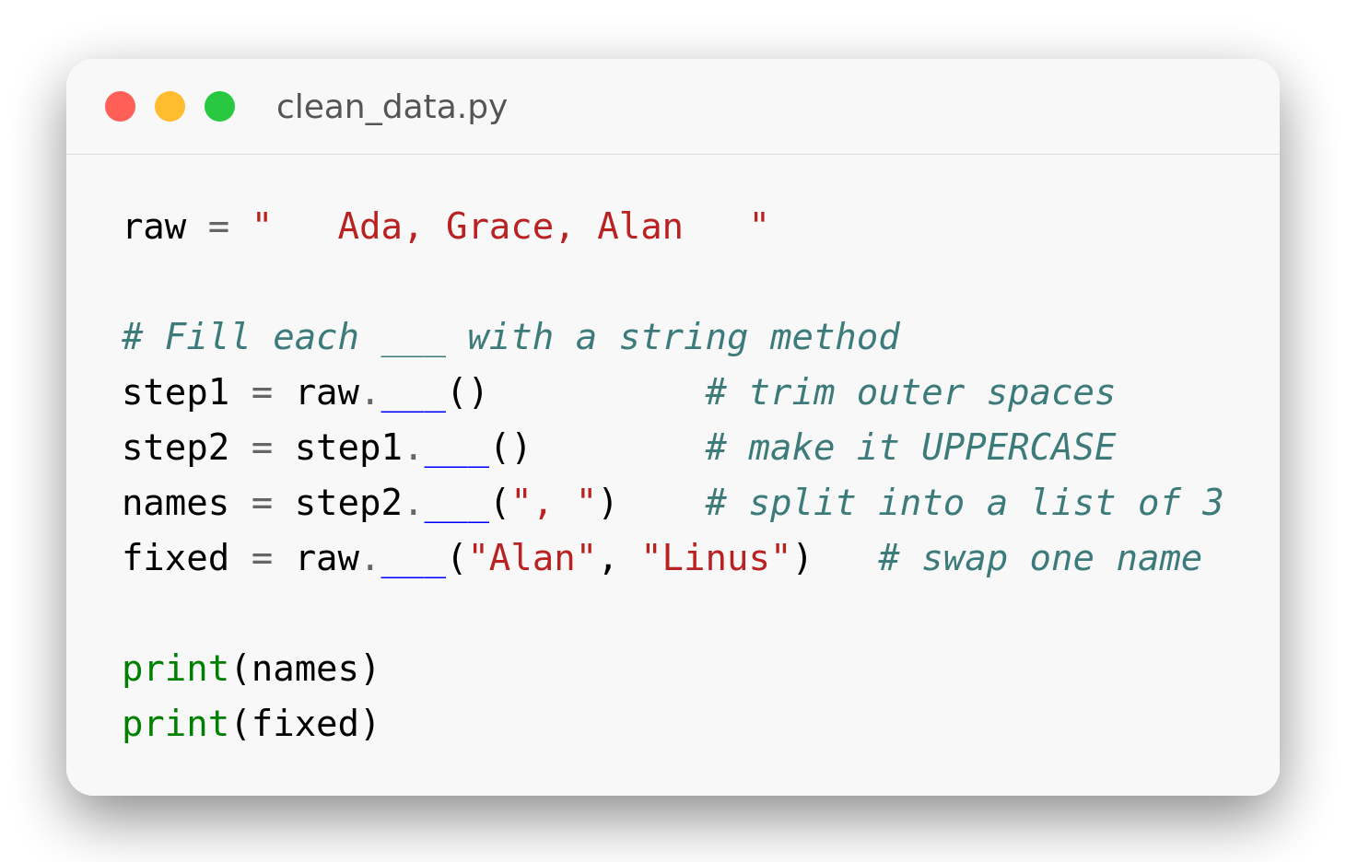
Clean the Data
TRY IT YOURSELF · ~8 MIN
Your task
Fill each ___ with the method that does the described job.
Methods can be chained: raw.strip().upper() runs left to right.
Stretch: print len(names) — how many names did split() produce?
Insight: strip() removes spaces only at the ends, never in the middle.
Notes:
raw = " Ada, Grace, Alan "
step1 = raw.strip()
step2 = step1.upper()
names = step2.split(", ")
fixed = raw.replace("Alan", "Linus")
print(names)
print(fixed)

Slide 27
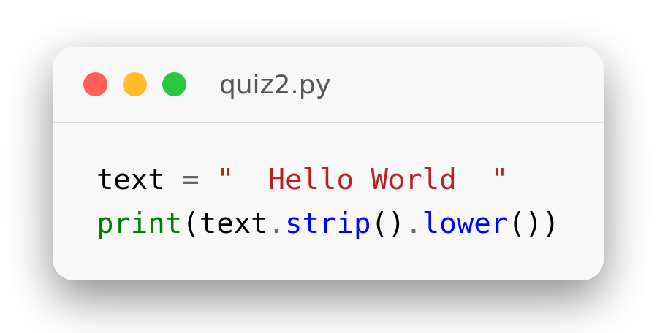
Chained Methods
KNOWLEDGE CHECK
A. " hello world "
B. "HELLO WORLD"
C. "hello world"
D. "Hello World"
Notes:
text = " Hello World "
print(text.strip().lower())

Slide 28
Python String Slicing
Exercises

Slide 29
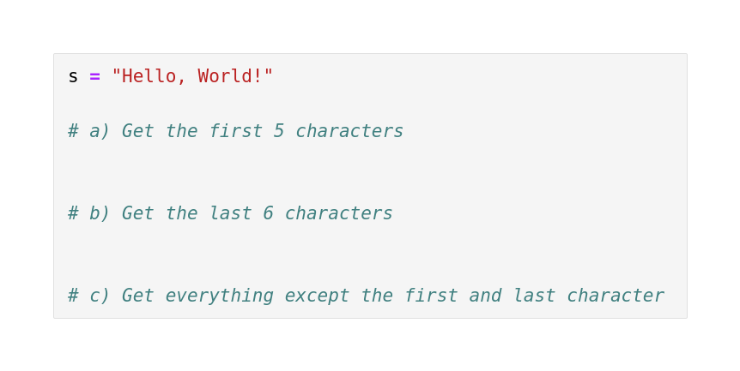
Exercise 1 · Basics
TRY IT YOURSELF · 3 MINUTES
Your task
s = "Hello, World!"
Slice out the first 5 and last 6 characters.
Drop the first and last character in one slice.
Notes:
s = "Hello, World!"
# a)
print(s[:5]) # 'Hello'
# b)
print(s[-6:]) # 'World!'
# c)
print(s[1:-1]) # 'ello, World'

Slide 30
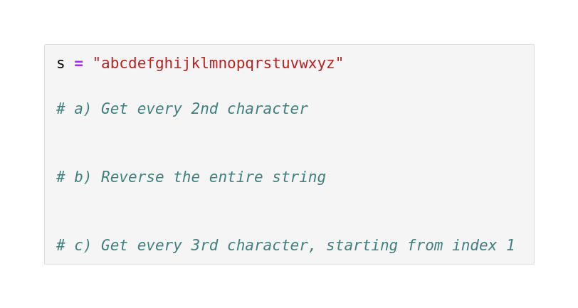
Exercise 2 · Step Slicing
TRY IT YOURSELF · 4 MINUTES
Your task
s = "abcdefghijklmnopqrstuvwxyz"
Take every 2nd character with a step slice.
Reverse the string using step -1.
Combine a start index and step 3.
Notes:
s = "abcdefghijklmnopqrstuvwxyz"
# a)
print(s[::2]) # 'acegikmoqsuwy'
# b)
print(s[::-1]) # 'zyxwvuts...a'
# c)
print(s[1::3]) # 'behknqtwz'

Slide 31
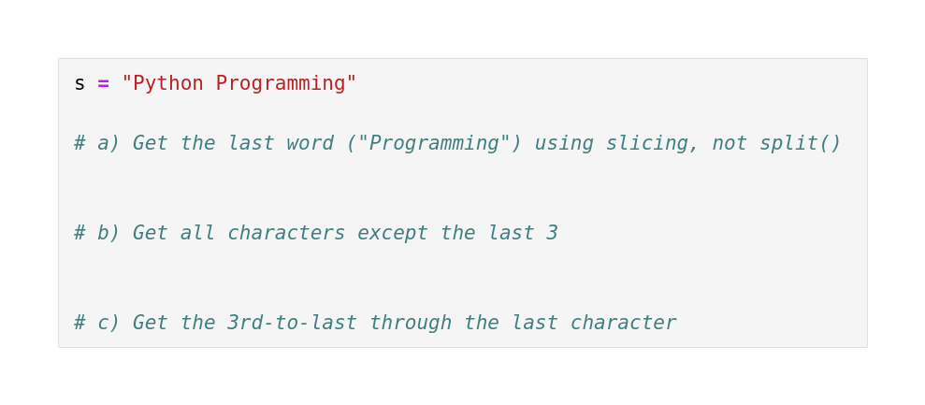
Exercise 3 · Negative Indices
TRY IT YOURSELF · 4 MINUTES
Your task
s = "Python Programming"
Pull the last word using negative indices, not `split()`.
Drop the last 3 characters.
Grab only the final 3 characters.
Notes:
s = "Python Programming"
# a)
print(s[-11:]) # 'Programming'
# b)
print(s[:-3]) # 'Python Programm'
# c)
print(s[-3:]) # 'ing'

Slide 32
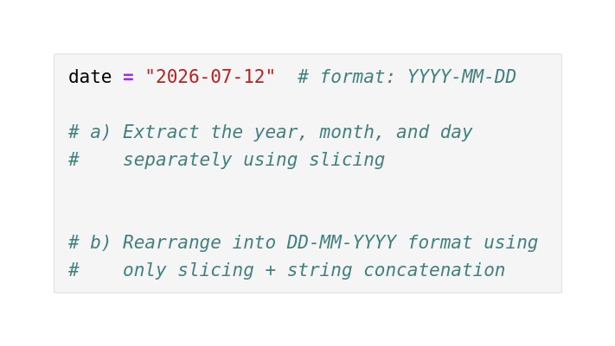
Exercise 4 · Extract & Rearrange
Your task
date = "2026-07-12"
Slice out the year, month, and day separately.
Concatenate into DD-MM-YYYY format.
Use only slicing + string ops — no `split()`.
Notes:
date = "2026-07-12"
# a)
year, month, day = date[:4], date[5:7], date[8:]
print(year, month, day) # 2026 07 12
# b)
rearranged = date[8:] + "-" + date[5:7] + "-" + date[:4]
print(rearranged) # 12-07-2026

Slide 33
Comparison & Logic
Ask true / false questions and combine them with and or not

Slide 34
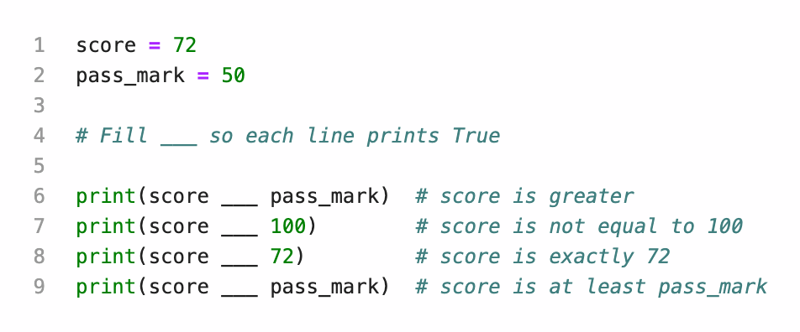
True or False?
TRY IT YOURSELF · ~6 MIN
Your task
Fill each ___ so that every line prints True.
Choose from == != < > <= >=.
A comparison always returns a boolean — True or False.
Notes:
score = 72
pass_mark = 50
print(score > pass_mark)
print(score != 100)
print(score == 72)
print(score >= pass_mark)

Slide 35
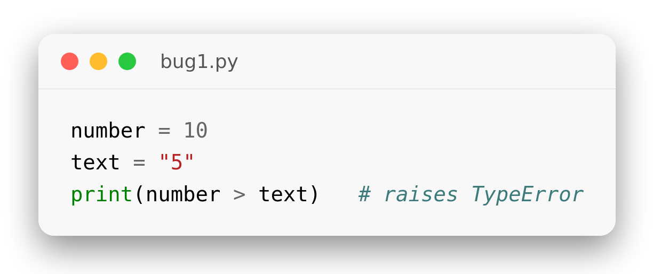
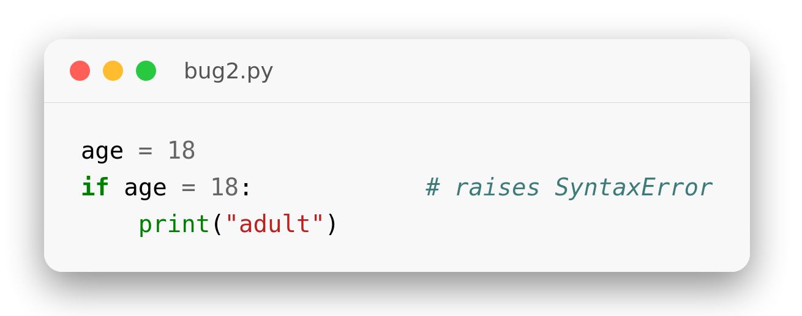
Fix the Bugs
DEBUG CHALLENGE
1 · Comparing an int with a str
2 · Assigning instead of comparing
3 · Spell out your logic words
Fix each snippet above, then rewrite this correctly: use age > 0 and age < 120 — the words and / or / not, not the symbols & or |.
Notes:
# Bug 1 fix
number = 10
text = "5"
print(number > int(text))
# Bug 2 fix
age = 18
if age == 18:
print("adult")

Slide 36
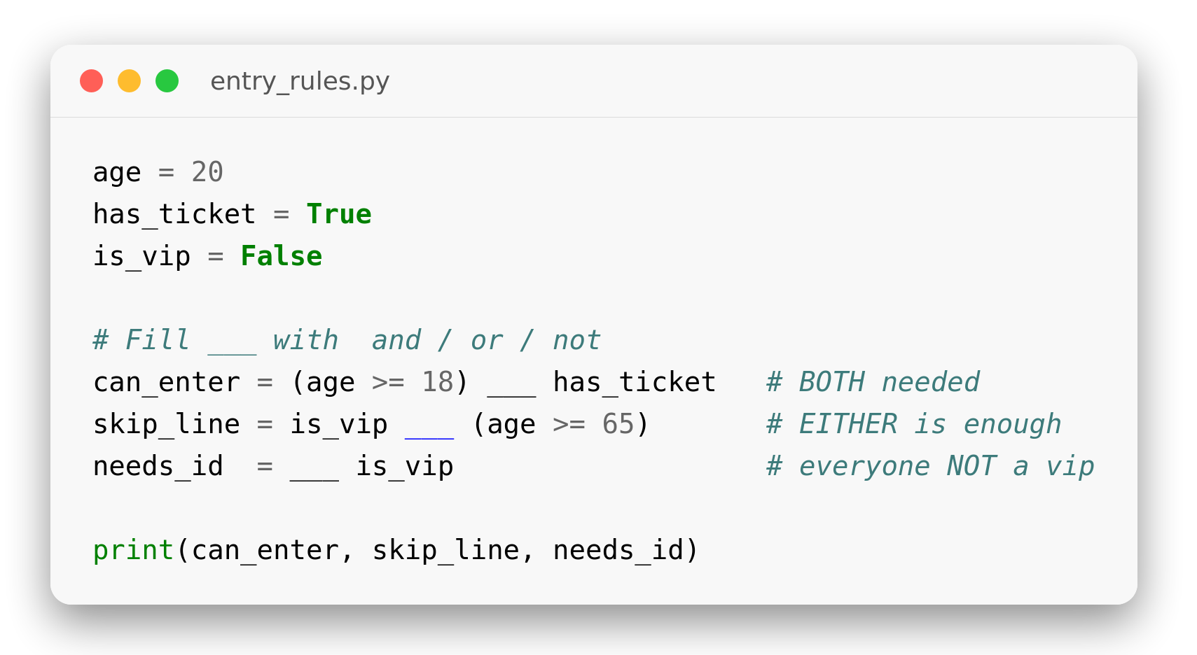
Logic Gates
TRY IT YOURSELF · ~8 MIN
Your task
Fill each ___ with and, or, or not.
and needs both true; or needs at least one; not flips it.
Predict the three booleans, then run to check.
Insight: not binds tightly: not is_vip flips just is_vip, not the whole line.
Notes:
age = 20
has_ticket = True
is_vip = False
can_enter = (age >= 18) and has_ticket
skip_line = is_vip or (age >= 65)
needs_id = not is_vip
print(can_enter, skip_line, needs_id)

